Slide 1
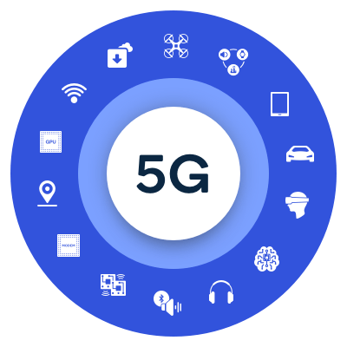
5G Network
.

Slide 2
What is 5G Network?
5G is the 5th generation of mobile networks, a significant evolution of todays 4G LTE networks. 5G has been designed to meet the very large growth in data and connectivity of today’s modern society, the internet of things with billions of connected devices, and tomorrow’s innovations. In addition to delivering faster connections and greater capacity, a very important advantage of 5G is the fast response time referred to as latency.

Slide 3
When did 5G Launch?
Initial 5G services commenced in many countries in 2019 and widespread availability of 5G is expected by 2025.

Slide 4
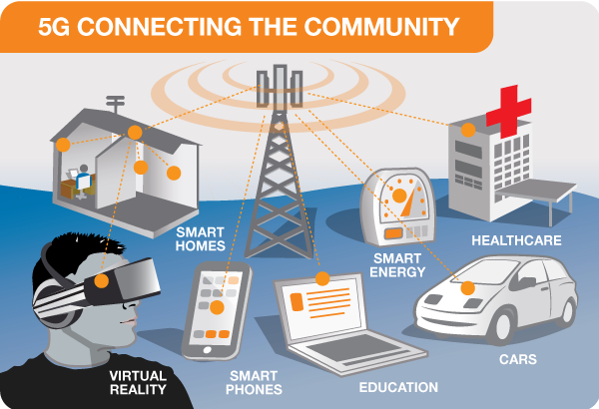
The Connected Community

Slide 5
How does 5G work?
Like 4G LTE, 5G is also OFDM-based (Orthogonal frequency-division multiplexing) and will operate based on the same mobile networking principles. However, the new 5GNR (New Radio) air interface will further enhance OFDM to deliver a much higher degree of flexibility and scalability.
5G will not only deliver faster, better mobile broadband services compared to 4G LTE, but it will also expand into new service areas, such as mission-critical communications and connecting the massive IoT. This is enabled by many new 5G NR air interface design techniques, such as a new self-contained TDD subframe design.

Slide 6
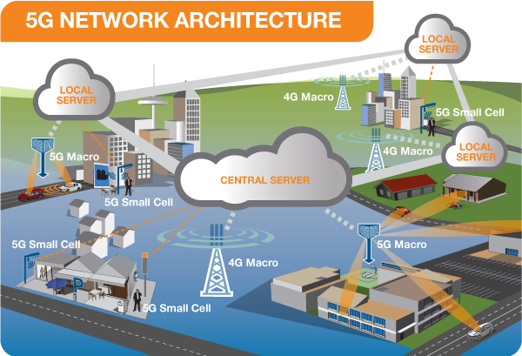
5G Network Connection

Slide 7
What will 5G Enable?
5G will provide the speed, low latency and connectivity to enable a new generation of applications, services and business opportunities that have not been seen before.
There are three major categories of use case for 5G:
Massive machine to machine communications – also called the Internet of Things (IoT) that involves connecting billions of devices without human intervention at a scale not seen before. This has the potential to revolutionise modern industrial processes and applications including agriculture, manufacturing and business communications.

Slide 8
What will 5G Enable?
Ultra-reliable low latency communications – mission critical including real-time control of devices, industrial robotics, vehicle to vehicle communications and safety systems, autonomous driving and safer transport networks. Low latency communications also opens up a new world where remote medical care, procedures, and treatment are all possible.
Enhanced mobile broadband – providing significantly faster data speeds and greater capacity keeping the world connected. New applications will include fixed wireless internet access for homes, outdoor broadcast applications without the need for broadcast vans, and greater connectivity for people on the move.

Slide 9
What are the differences between previous generation of network and 5G?
The previous generations of mobile networks are 1G, 2G, 3G, and 4G.
First generation - 1G 1980s: 1G delivered analog voice.
Second generation - 2G Early 1990s: 2G introduced digital voice
Third generation - 3G Early 2000s: 3G brought mobile data.

Slide 10
What are the differences between previous generation of network and 5G?
Fourth generation - 4G LTE 2010s: 4G LTE ushered in the era of mobile broadband.
1G, 2G, 3G, and 4G all led to 5G, which is designed to provide more connectivity than was ever available before.
5G is a unified, more capable air interface. It has been designed with an extended capacity to enable next-generation user experiences, empower new deployment models and deliver new services.

Slide 11
How is 5G better than 4G?
There are several reasons that 5G will be better than 4G:
• 5G is significantly faster than 4G • 5G has more capacity than 4G • 5G has significantly lower latency than 4G • 5G is a unified platform that is more capable than 4G • 5G uses spectrum better than 4G

Slide 12
Where is 5G being used?
Broadly speaking, 5G is used across three main types of connected services, including enhanced mobile broadband, mission-critical communications, and the massive IoT. A defining capability of 5G is that it is designed for forward compatibility—the ability to flexibly support future services that are unknown today.

Slide 13
Enhanced mobile broadband In addition to making our smartphones better, 5G mobile technology can usher in new immersive experiences such as VR and AR with faster, more uniform data rates, lower latency, and lower cost-per-bit.
Mission-critical communications 5G can enable new services that can transform industries with ultra-reliable, available, low-latency links like remote control of critical infrastructure, vehicles, and medical procedures.

Slide 14
Massive IoT 5G is meant to seamlessly connect a massive number of embedded sensors in virtually everything through the ability to scale down in data rates, power, and mobility—providing extremely lean and low-cost connectivity solutions.

Slide 15
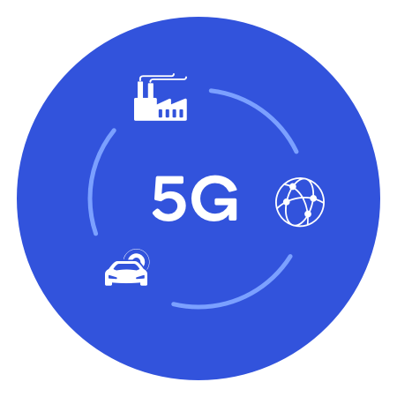

Slide 16
When will 5G be available to more people?
As with previous generations of mobile networks, it will take time to proliferate the new 5G network to make it available to more people. In the meantime, 4G LTE will continue to grow and serve as the anchor of the 5G mobile experience (via multi-connectivity) for many years to come by providing Gigabit data rates outside 5G coverage areas.

Slide 17

Audio File:

Slide 18
Thank You

